Slide 1
Matrices
Computer Science, Purdue University
Copyright McGraw Hill, Rosen, Discrete Mathematics and its Applications

Slide 2
Matrices
Matrices: Overview
Matrices are useful discrete structures that can be used in many ways. For example, they are used to:
Describe certain types of functions known as linear transformations.
Express which vertices of a graph are connected by edges.
In Machine Learning, Data Mining, and Information Retrieval, they play essential roles.
Computer Science, Purdue University

Slide 3

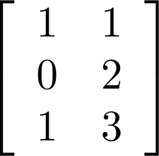
Matrices
Matrices: Definitions
Definition: A matrix is a rectangular array of numbers. A matrix with m rows and n columns is called an m n matrix.
The plural of matrix is matrices.
A matrix with the same number of rows as columns is called square.
Two matrices are equal if they have the same number of rows and the same number of columns and the corresponding entries in every position are equal.
3 2 matrix
Computer Science, Purdue University

Slide 4
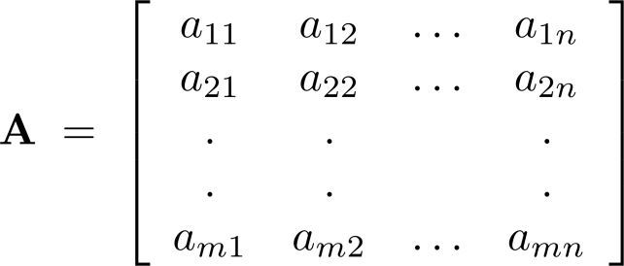
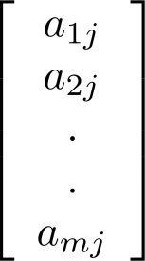
Matrices
Matrices: Notation
Let m and n be positive integers and let
The ith row of A is the 1 X n matrix [a_{i1}, a_{i2},…,a_{in}].
The jth column of A is the m X 1 matrix:
The (i,j)th element or entry of A is the
element a_{ij}. We can use A = [a_{ij} ] to denote the matrix with its (i,j)th element equal to a_{ij}.
Computer Science, Purdue University

Slide 5
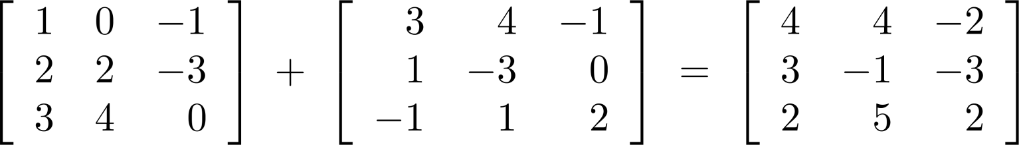
Matrices
Matrix Addition
Defintion: Let A = [a_{ij}] and B = [b_{ij}] be m X n matrices. The sum of A and B, denoted by A + B, is the m X n matrix that has a_{ij} + b_{ij} as its (i,j)th element. In other words, A + B = [a_{ij} + b_{ij}].
Example:
Note that matrices of different sizes can not be added.
Computer Science, Purdue University

Slide 6
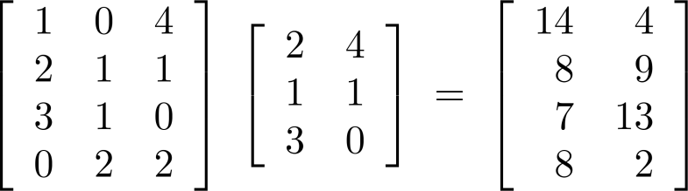
Matrices
Matrix Multiplication
Definition: Let A be an m X k matrix and B be a k X n matrix. The product of A and B, denoted by AB, is the m X n matrix that has its (i,j)th element equal to the sum of the products of the corresponding elements from the ith row of A and the jth column of B. In other words, if AB = [c_{ij}] then c_{ij} = a_{i1}b_{1j} + a_{i2}b_{2j} + … + a_{kj}b_{2j}.
Example:
The product of two matrices is undefined when the number of columns in the first matrix is not the same as the number of rows in the second.
Computer Science, Purdue University

Slide 7
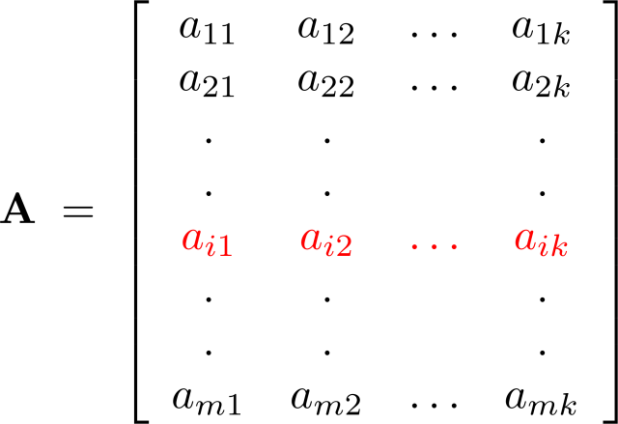
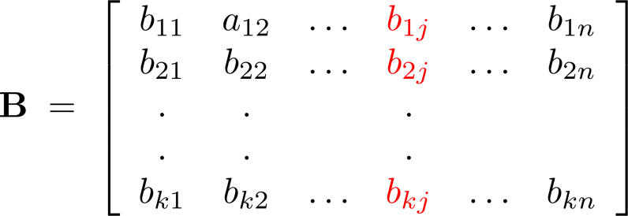
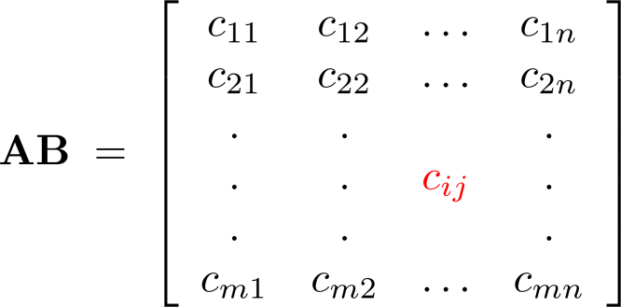
Matrices
Matrix Multiplication
The Product of A = [a_{ij}] and B = [b_{ij}]
Computer Science, Purdue University

Slide 8
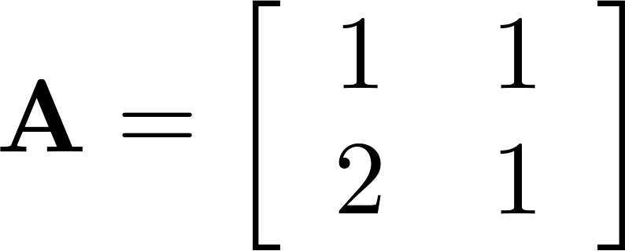
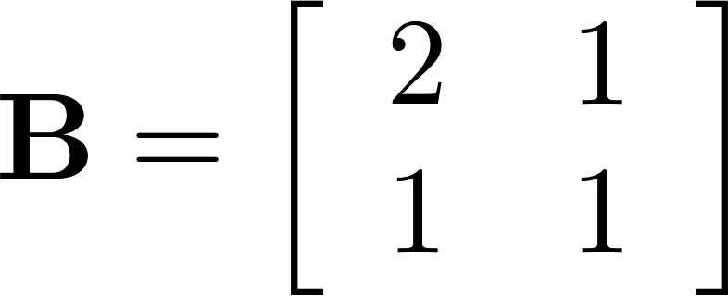
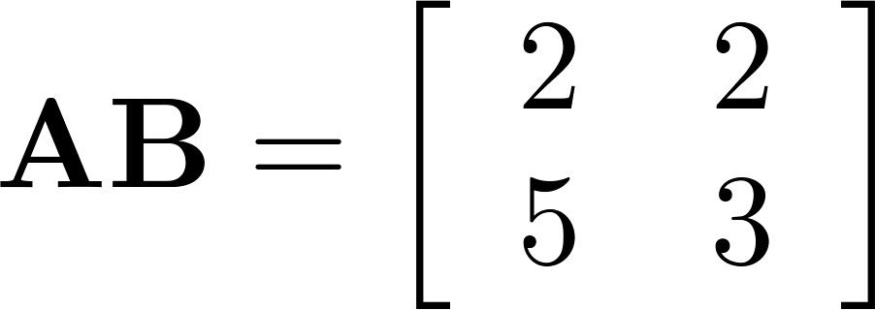
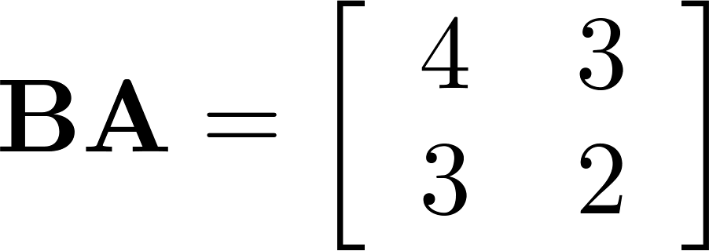
Matrices
Matrix Multiplication is not Commutative
Example: Let
Does AB = BA?
Solution:
AB ≠ BA
Computer Science, Purdue University

Slide 9
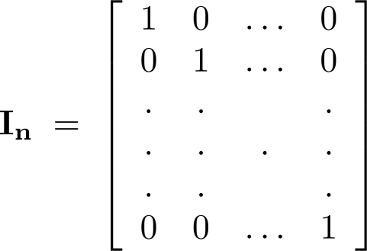
Matrices
Identity Matrix and Powers of Matrices
Definition: The identity matrix of order n is the n X n matrix I_{n} = [δ_{ij}], where δ_{ij} = 1 if i = j and δ_{ij} = 0 if i≠j.
AI_{n} = I_{m}A = A
when A is an m X n matrix
Powers of square matrices can be defined. When A is an n × n matrix, we have:
A⁰ = I_{n} A^{r} = AAA∙∙∙A
r times
Computer Science, Purdue University

Slide 10
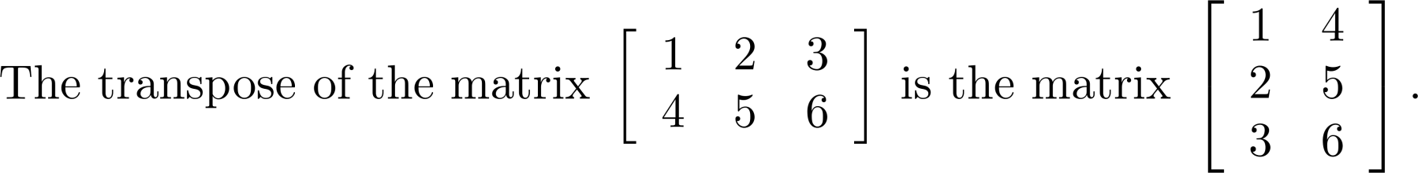
Matrices
Transposes of Matrices
Definition: Let A = [a_{ij}] be an m X n matrix. The transpose of A, denoted by A^{t} , is the n X m matrix obtained by interchanging the rows and columns of A.
If A^{t} = [b_{ij}], then b_{ij} = a_{ji} for i =1,2,…,n and j = 1,2, ...,m.
Computer Science, Purdue University

Slide 11
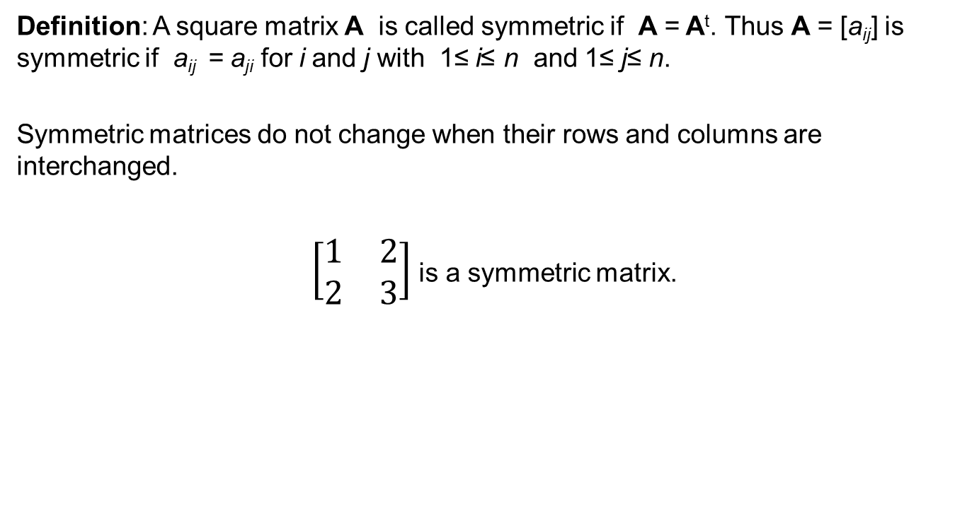
Matrices
Transposes of Matrices
Definition: A square matrix A is called symmetric if A = A^{t}. Thus A = [a_{ij}] is symmetric if a_{ij} = a_{ji} for i and j with 1≤ i≤ n and 1≤ j≤ n.
Symmetric matrices do not change when their rows and columns are interchanged.
$\left[\begin{matrix}1 & 2 \\ 2 & 3\end{matrix}\right]$ is a symmetric matrix.
Computer Science, Purdue University

Slide 12
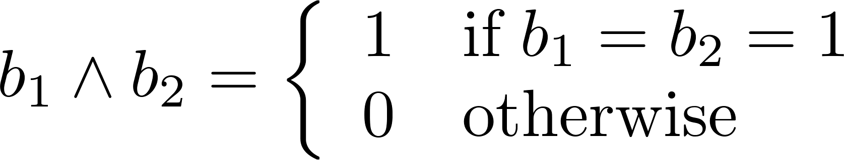
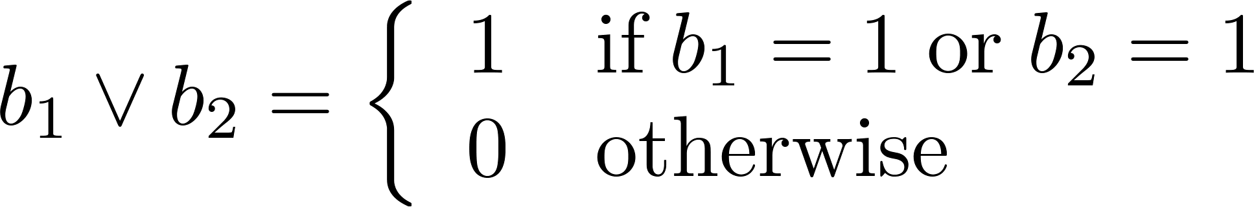
Matrices
Zero-One Matrices
Definition: A matrix all of whose entries are either 0 or 1 is called a zero-one matrix.
Algorithms operating on discrete structures represented by zero-one matrices are based on Boolean arithmetic defined by the following Boolean operations:
Computer Science, Purdue University

Slide 13
Matrices
Zero-One Matrices
Definition: Let A = [a_{ij}] and B = [b_{ij}] be an m × n zero-one matrices.
The join of A and B is the zero-one matrix with (i,j)th entry a_{ij} ∨ b_{ij}. The join of A and B is denoted by A ∨ B.
The meet of of A and B is the zero-one matrix with (i,j)th entry a_{ij} ∧ b_{ij}. The meet of A and B is denoted by A ∧ B.
Computer Science, Purdue University

Slide 14
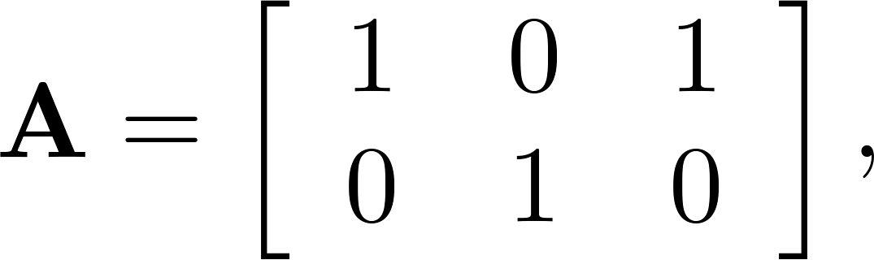
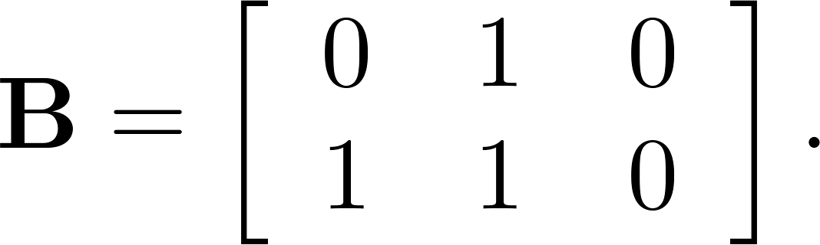
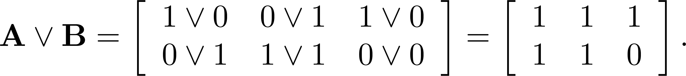
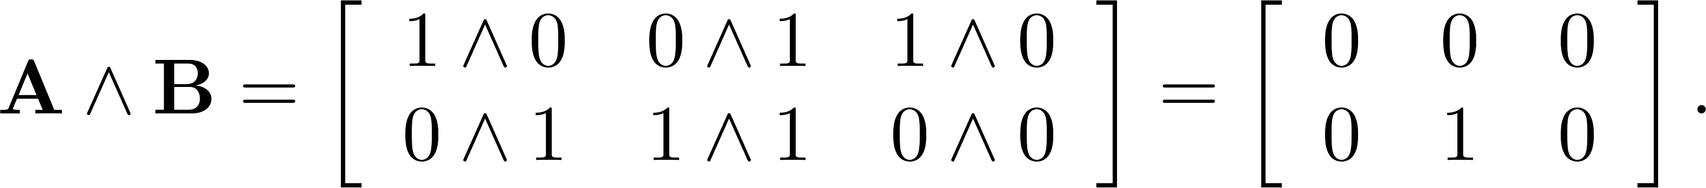
Matrices
Joins and Meets of Zero-One Matrices
Example: Find the join and meet of the zero-one matrices
Solution: The join of A and B is
The meet of A and B is
Computer Science, Purdue University

Slide 15
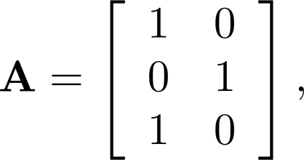
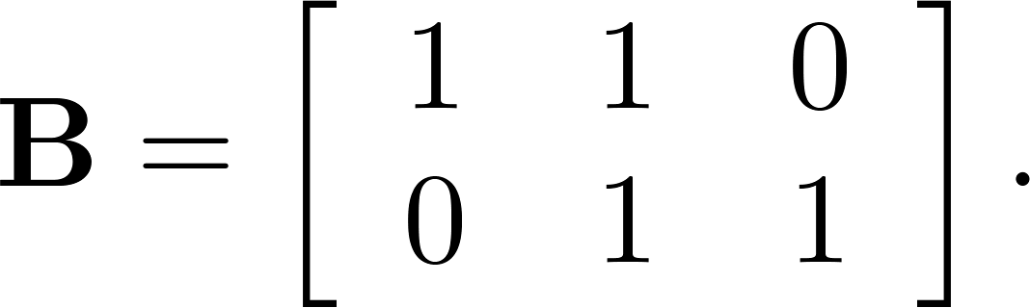
Matrices
Boolean Product of Zero-One Matrices
Definition: Let A = [a_{ij}] be an m X k zero-one matrix and B = [b_{ij}] be a k X n zero-one matrix. The Boolean product of A and B, denoted by A ⊙ B, is the m X n zero-one matrix with(i,j)th entry
c_{ij} = (a_{i1} ∧ b_{1j})∨ (a_{i2} ∧ b_{2j}) ∨ … ∨ (a_{ik} ∧ b_{kj})
Example: Find the Boolean product of A and B, where
Computer Science, Purdue University

Slide 16
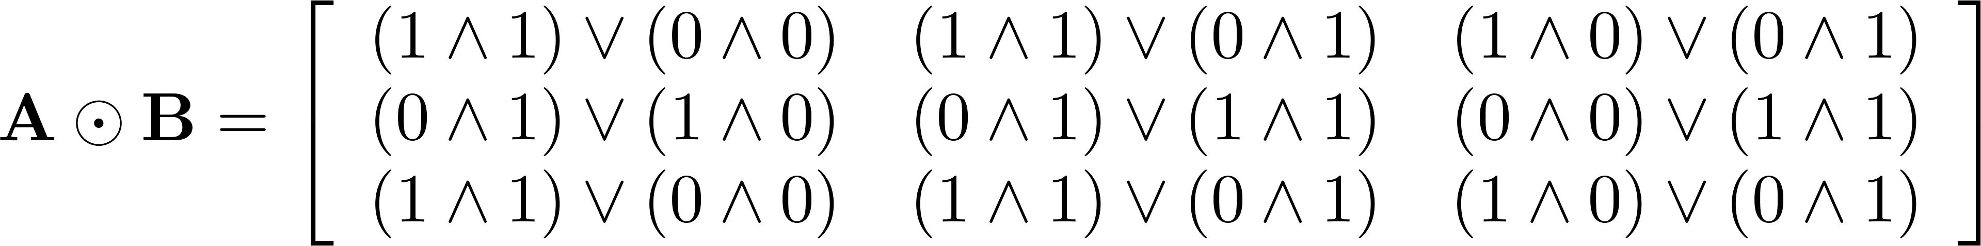
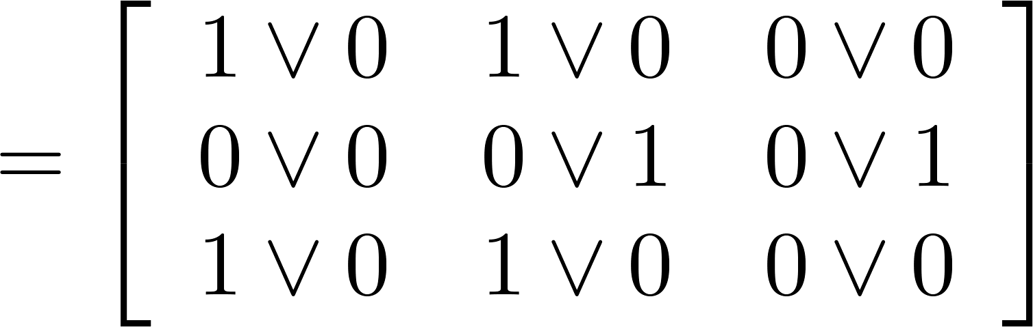
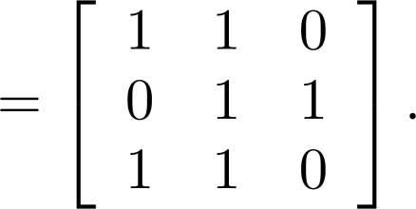
Matrices
Boolean Product of Zero-One Matrices
Solution: The Boolean product A ⊙ B is given by
Computer Science, Purdue University

Slide 17
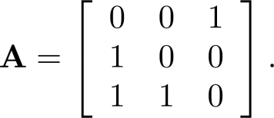
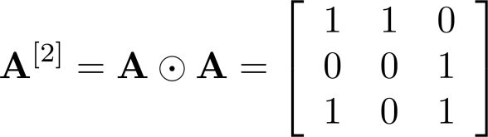
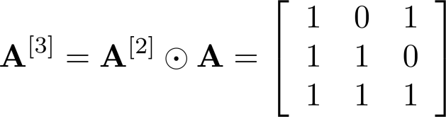
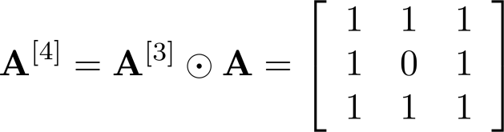
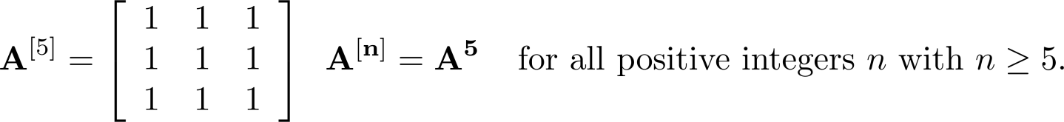
Matrices
Boolean Powers of Zero-One Matrices
Example: Let
Find A^{n} for all positive integers n.
Solution:
Computer Science, Purdue University

Slide 18
Thank You

